Slide 1
Pizza Sales Analysis
Using SQL & Power BI
Data-Driven Business Insights

Slide 2
Project Overview
• Analyzed real-world pizza sales dataset using SQL and Power BI.
• SQL used for data querying, KPI calculation, and trend analysis.
• Used GROUP BY, CTEs, and Window Functions.
• Power BI used to create interactive dashboards.
• Focused on sales performance, customer behavior, and product trends.

Slide 3
Project Objectives
1. Calculate KPIs: Total Revenue, Total Orders, Average Order Value.
2. Identify top-performing pizzas by revenue and quantity.
3. Analyze monthly and seasonal sales trends.
4. Compare sales by size and category.
5. Generate data-driven insights for business decisions.

Slide 4
Key KPIs
• Total Revenue
• Total Orders
• Average Order Value (AOV)
• Total Pizzas Sold
• Category-wise Sales Contribution

Slide 5
SQL Techniques Used
• GROUP BY – Category & Size Analysis
• CTEs – Structured Complex Queries
• Window Functions – Ranking & Trend Analysis
• Aggregate Functions – SUM, COUNT, AVG
• Date Functions – Monthly Trend Analysis

Slide 6
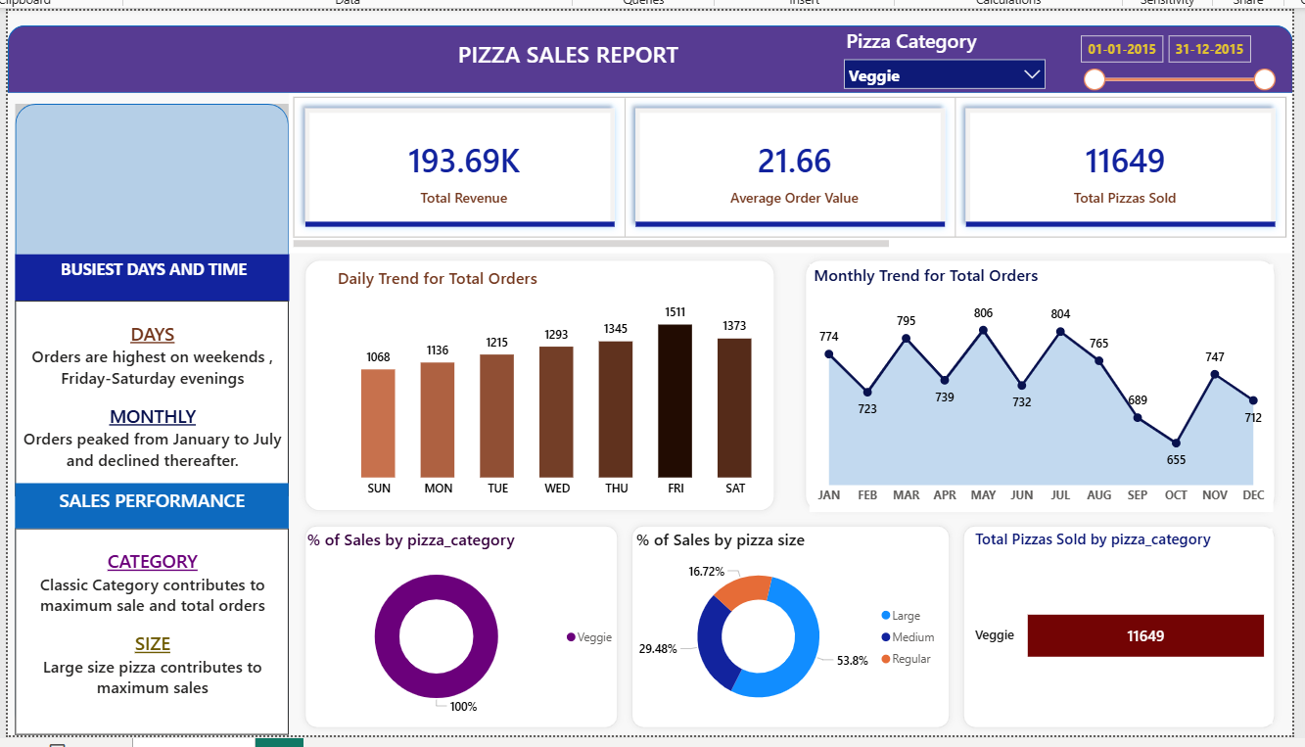
Power BI Dashboard - Veggie Category

Slide 7
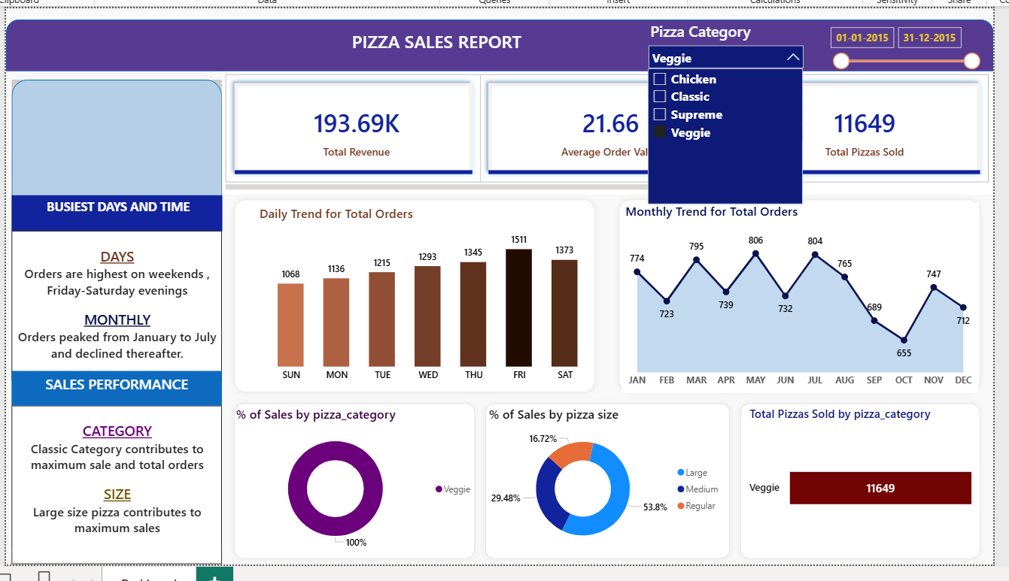
Power BI Dashboard - Chicken Category

Slide 8
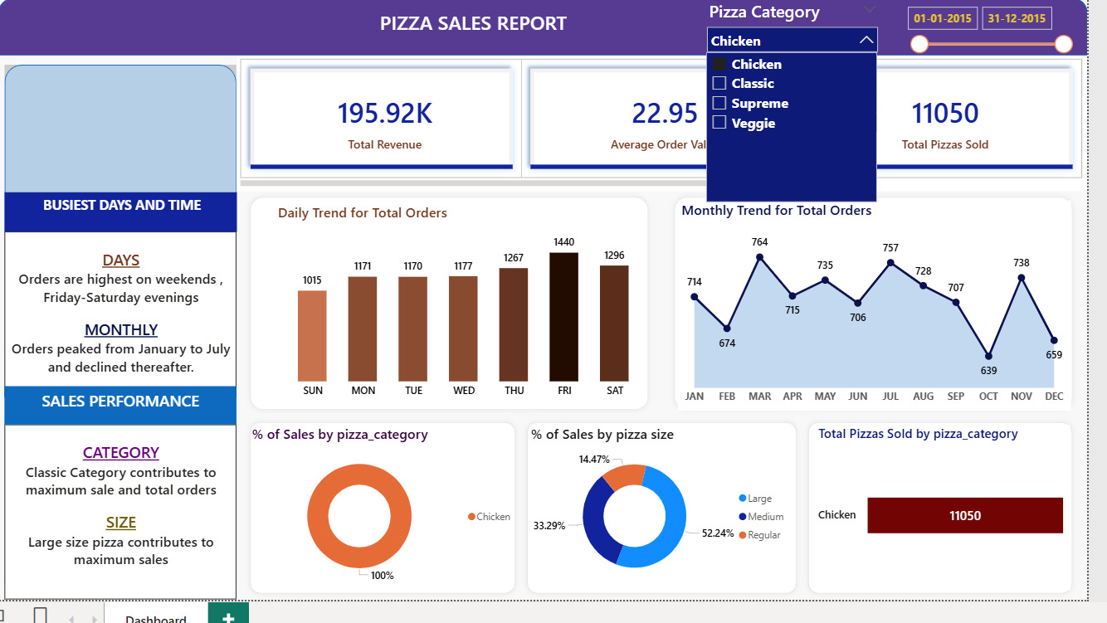
Power BI Dashboard - Classic Category

Slide 9
Key Business Insights
• Classic category contributes maximum revenue.
• Large size pizzas generate highest sales.
• Orders peak between January to July.
• Weekends (Friday–Saturday evenings) are busiest.
• Seasonal demand patterns impact monthly revenue.

Slide 10
Conclusion
• SQL enabled deep business analysis.
• Power BI helped visualize complex insights.
• Dashboard supports data-driven decision-making.
• Identified growth opportunities in size & category segments.

